Slide 1
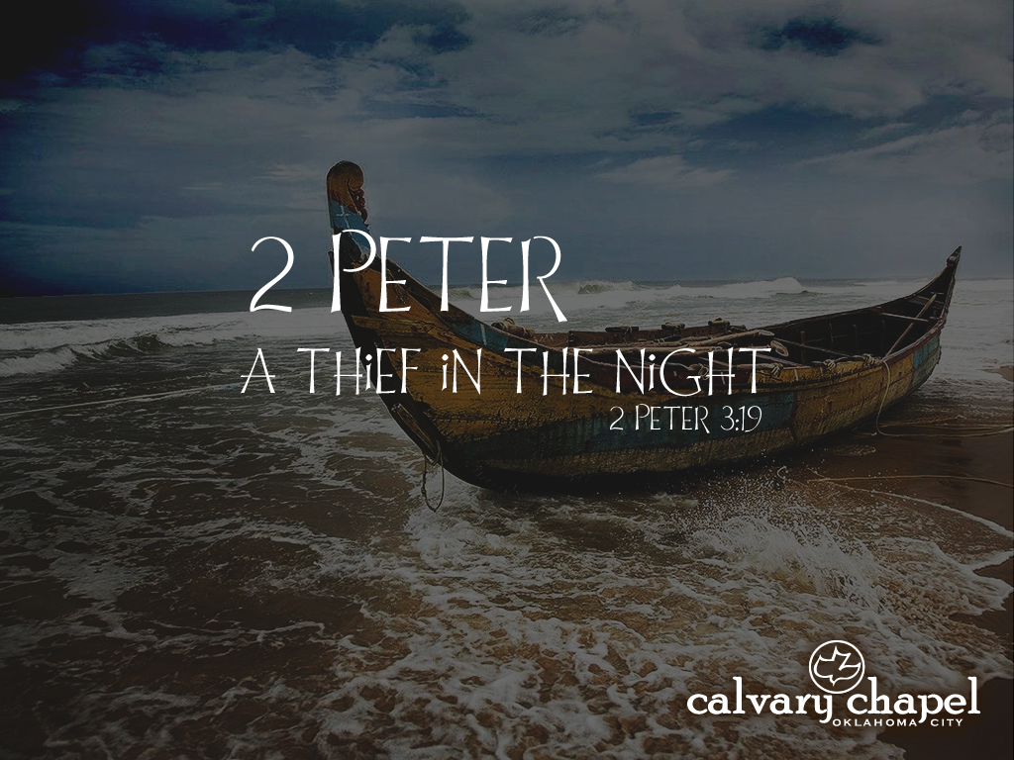
2:12-22

Slide 2



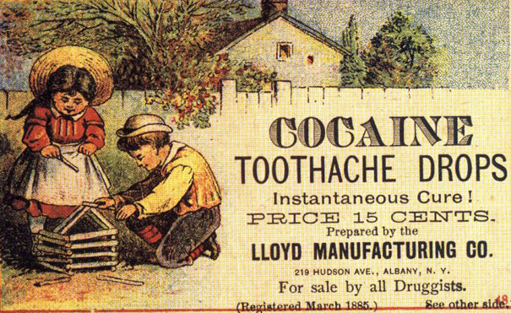
2:12-22

Slide 3


2:12-22

Slide 4

2:12-22

Slide 5
2:12-22
2 Peter 2:12–22 ~ ¹² But these, like natural brute beasts made to be caught and destroyed, speak evil of the things they do not understand, and will utterly perish in their own corruption, ¹³ and will receive the wages of unrighteousness, as those who count it pleasure to carouse in the daytime. They are spots and blemishes, carousing in their own deceptions while they feast with you, ¹⁴ having eyes full of adultery and that cannot cease from sin, enticing unstable souls. They have a heart trained in covetous practices, and are accursed children. ¹⁵ They have forsaken the right way

Slide 6
2:12-22
2 Peter 2:12–22 ~ and gone astray, following the way of Balaam the son of Beor, who loved the wages of unrighteousness; ¹⁶ but he was rebuked for his iniquity: a dumb donkey speaking with a man’s voice restrained the madness of the prophet.
¹⁷ These are wells without water, clouds carried by a tempest, for whom is reserved the blackness of darkness forever.
¹⁸ For when they speak great swelling words of emptiness, they allure through the lusts of the flesh, through lewdness,

Slide 7
2:12-22
2 Peter 2:12–22 ~ the ones who have actually escaped from those who live in error. ¹⁹ While they promise them liberty, they themselves are slaves of corruption; for by whom a person is overcome, by him also he is brought into bondage. ²⁰ For if, after they have escaped the pollutions of the world through the knowledge of the Lord and Savior Jesus Christ, they are again entangled in them and overcome, the latter end is worse for them than the beginning. ²¹ For it would have been better for them not to have known the way of righteousness, than having known it,

Slide 8
2:12-22
2 Peter 2:12–22 ~ to turn from the holy commandment delivered to them. ²² But it has happened to them according to the true proverb: “A dog returns to his own vomit,” and, “a sow, having washed, to her wallowing in the mire.”

Slide 9
2:12-22

Slide 10
2:12-22
Who is Jesus?
Mormon Jesus ~ one of many “spirit-children”
Watchtower Jesus ~ first created being (Michael the Archangel)
Word of Faith Jesus ~ first He was God; then he wasn’t; then He was again
“Po Mo” Jesus ~ maybe He is; maybe he isn’t …
whatev

Slide 11
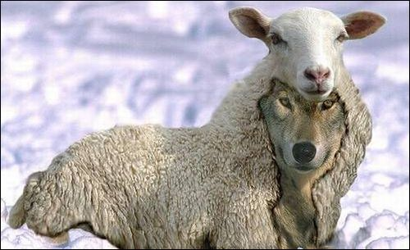
2:12-22

Slide 12
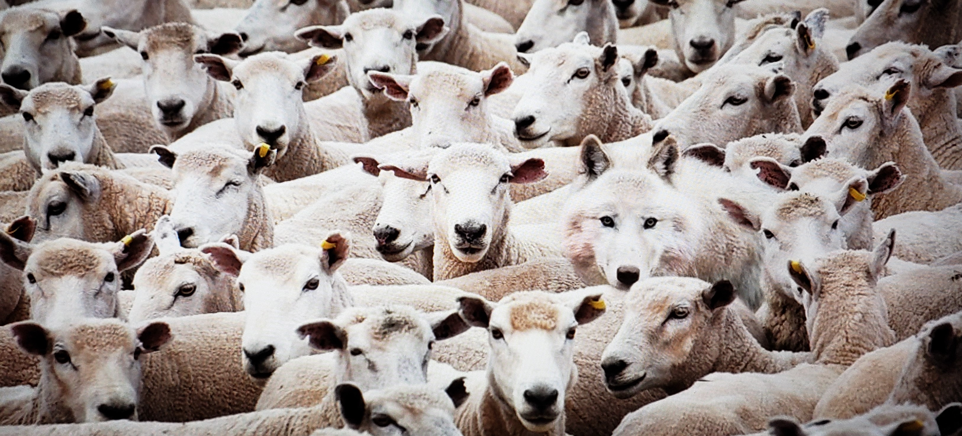
2:12-22

Slide 13
2:12-22

Slide 14
2:12-22
Two kinds of false teachers:
1) The charlatans and grafters
2 Peter 2:3a ~ By covetousness they will exploit you with deceptive words …
1 Tim. 6:5 ~ … suppose godliness is a means of gain.
2) Those who are sincere, yet sincerely wrong

Slide 15
2:12-22

Slide 16
2:12-22
Merrihew Standard Version ~ In the same way that vermin will follow their natural instincts and whose only purpose seems to be that of being caught and eliminated, so also these false teachers follow their own passions and desires. In this regard they are no different from the wanton pleasure-seekers who will undoubtedly reap what they have sown and their demise with be likewise.

Slide 17
2:12-22

Slide 18
2:12-22
spots ~ inherent defect
blemishes ~ acquired defect

Slide 19
2:12-22

Slide 20
2:12-22
trained ~ KJV, exercised
gumnazō – gymnasium

Slide 21
2:12-22

Slide 22
2:12-22
Balaam ~ Num. 22-24, 33
Rev. 2:14 ~ But I have a few things against you, because you have there those who hold the doctrine of Balaam, who taught Balak to put a stumbling block before the children of Israel, to eat things sacrificed to idols, and to commit sexual immorality.
The doctrine of Balaam is the end justifies the means

Slide 23
2:12-22
Balaam ~ Num. 22-24, 33
Jude 1:11 ~ Woe to them! For they have gone in the way of Cain, have run greedily in the error of Balaam for profit, and perished in the rebellion of Korah.
The error of Balaam is to think you can get away with it

Slide 24
2:12-22
Balaam ~ Num. 22-24, 33
2 Peter 2:15 ~ They have forsaken the right way and gone astray, following the way of Balaam the son of Beor, who loved the wages of unrighteousness;
The way of Balaam is the money trail

Slide 25
2:12-22

Slide 26
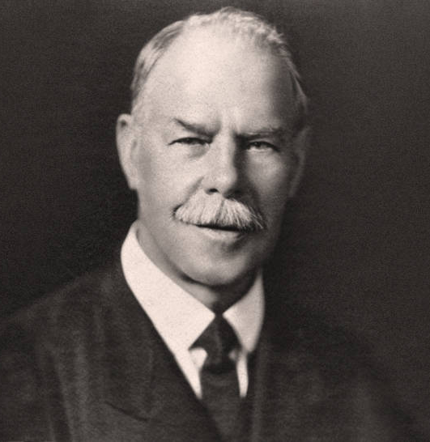
2:12-22
Smith Wigglesworth (1859-1957) ~
“I don't hit them, I hit the devil.”
“I’ll only pray for you once, to pray twice is unbelief.”
“Didn’t I pray for you last night? You are full of unbelief, get off this platform!”

Slide 27

2:12-22
Shepherding Movement
Apostles and Prophets Movement
Holy Laughter Movement
Barking and Growling Movement
Jerking and Twitching Movement
Gold dust
and Gold fillings Movement

Slide 28
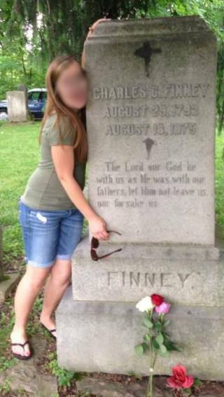
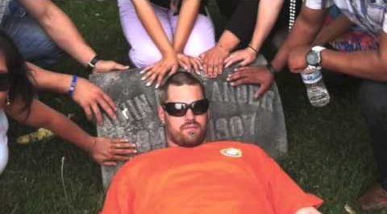
2:12-22
Pastor from Northern California ~ “None of us has a full grasp of Scripture, but we all have the Holy Spirit. He is our common denominator who will always lead us into truth. But to follow Him, we must be willing to follow off the map—to go beyond what we know.”
“It’s difficult to expect the same fruit of the early church when we value a book they didn’t have more than the Holy Spirit they did have. It’s not Father, Son and Holy Bible.”

Slide 29
2:12-22

Slide 30
2:12-22
Paul Washer ~ “One of the greatest distinguishing marks of a false prophet is that he will always tell you what you want to hear, he will never rain on your parade; he will get you clapping, he will get you jumping, he will make you dizzy, he will keep you entertained, and he will present a Christianity to you that will make your church look like Six Flags Over Jesus.”

Slide 31
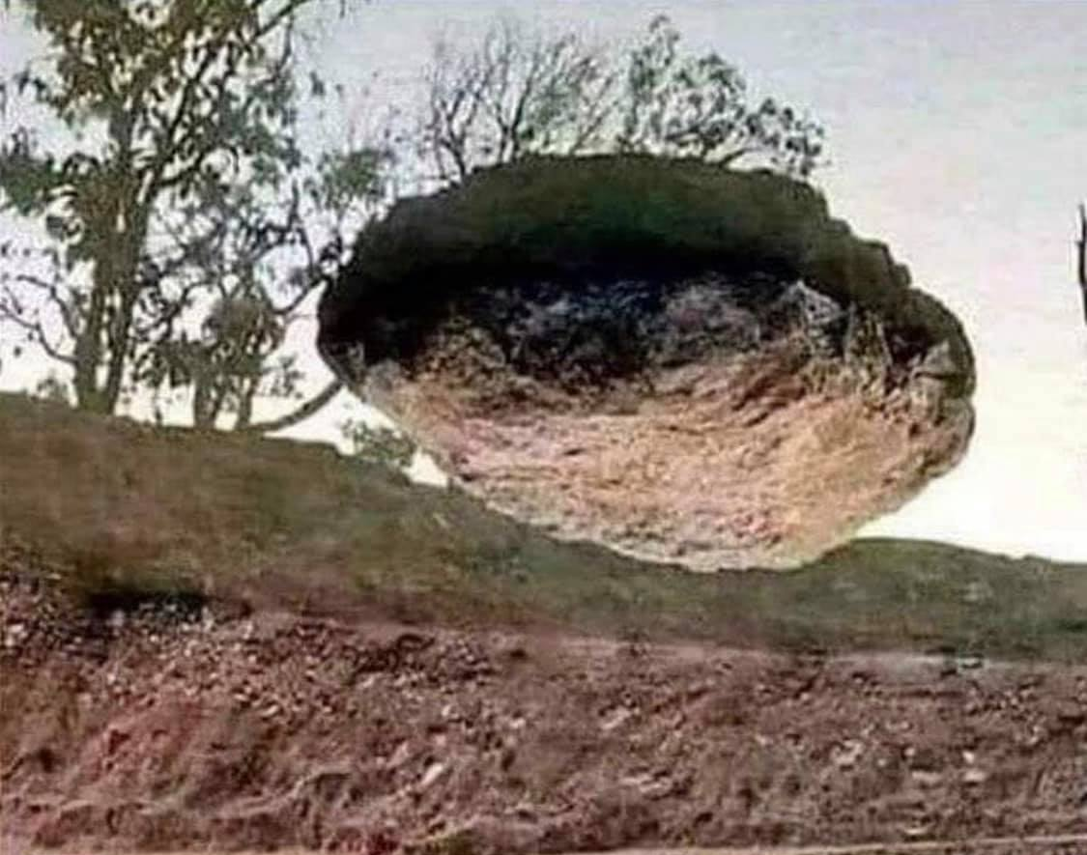
2:12-22
This picture is real and unedited; the stone is real; the trees are real, the soil is real; the sky is real

Slide 32
2:12-22

Slide 33


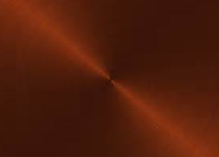

2:12-22
Premodernism
Modernism
Postmodernism
1500
1600
1700
1800
1900
2000
The premodernism: age of religion and superstition
The modernism: science, reason and technology
The postmodernism: spirituality but questions authority and absolutes

Slide 34
2:12-22
Postmodernism doesn’t deny absolutes
Postmodernism just questions the ability to determine absolutes
IOW, Postmodernism denies absolutes

Slide 35
2:12-22

Slide 36
2:12-22
C. H. Spurgeon (1834-1892) ~ “If your theology doesn't change your behavior, it will never change your destiny.”

Slide 37


2:12-22
My dogma just ran over your karma
Non-censor
Millenn
ial,
pie,
ster,
hip
generation

Slide 38
2:12-22
Vance Havner (1901-1986) ~ “Too much of our orthodoxy is correct and sound, but like words without a tune, it does not glow and burn; it does not stir the heart; it has lost its hallelujah. One man with a genuine glowing experience with God is worth a library full of arguments.”

Slide 39

2:12-22

Slide 40
2:12-22

Slide 41
2:12-22
This picture is real and unedited; the stone is real; the trees are real, the soil is real; the sky is real
1 Thess. 5:20-21 ~ ²⁰ Do not despise prophecies. ²¹ Test all things; hold fast what is good.

Slide 42
2:12-22

